Slide 1
Shell Scripting

Slide 2
Shell Scripting She-bang
The sign #! is called she-bang and is written at top of the script. It passes instruction to program /bin/sh.
To run your script in a certain shell (shell should be supported by your system), start your script with #! followed by the shell name.
#!/bin/bash
echo Hello World

Slide 3
Shell Scripting Comments
Any line starting with a hash (#) becomes comment. Comment means, that line will not take part in script execution. It will not show up in the output.

Slide 4
Shell Scripting Variables
#!/bin/bash
var1 = hello
var2 = Malkeet
echo “$var1 $var2”
output hello Malkeet
#!/bin/bash
var1=50
echo $var1
output 50

Slide 5
Steps to write and execute a script
Open the terminal. Go to the directory where you want to create your script.
Create a file with .sh extension.
Write the script in the file using an editor.
Make the script executable with command chmod +x <fileName>.
Run the script using ./<fileName>. OR bash filename.sh
We can use vi editor to write in .sh file

Slide 6
Shell Script Parameters
A bash shell script have parameters. These parameters start from $1 to $9.
When we pass arguments into the command line interface, a positional parameter is assigned to these arguments through the shell.
The first argument is assigned as $1, second argument is assigned as $2 and so on...
If there are more than 9 arguments, then tenth or onwards arguments can't be assigned as $10 or $11.

Slide 7
If else and syntax
#! /bin/bash
count=10
if [ "$count" -eq 10 ]
then
echo "condition is true"
elif (("$count">10))
then
echo "condition may be false"
else
echo "condiotion is false"
fi

Slide 8
While loop in shell
#!/bin/bash
i=1
while [[ $i -le 10 ]] ; do
echo "$i"
(( i += 1 ))
done

Slide 9
for loop
#!/bin/bash
number=1
rows=6
for((i=1; i<=rows; i++))
do
for((j=1; j<=i; j++))
do
echo -n $number
number=$((number+1))
done
echo
number=1
done

Slide 10
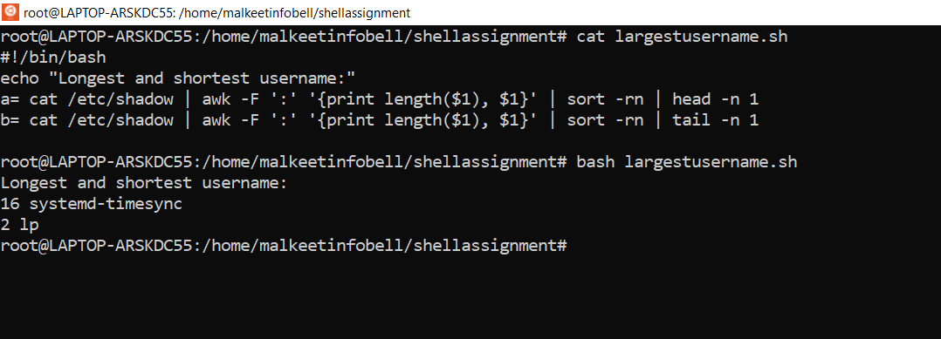
Largest and shortest user name

Slide 11
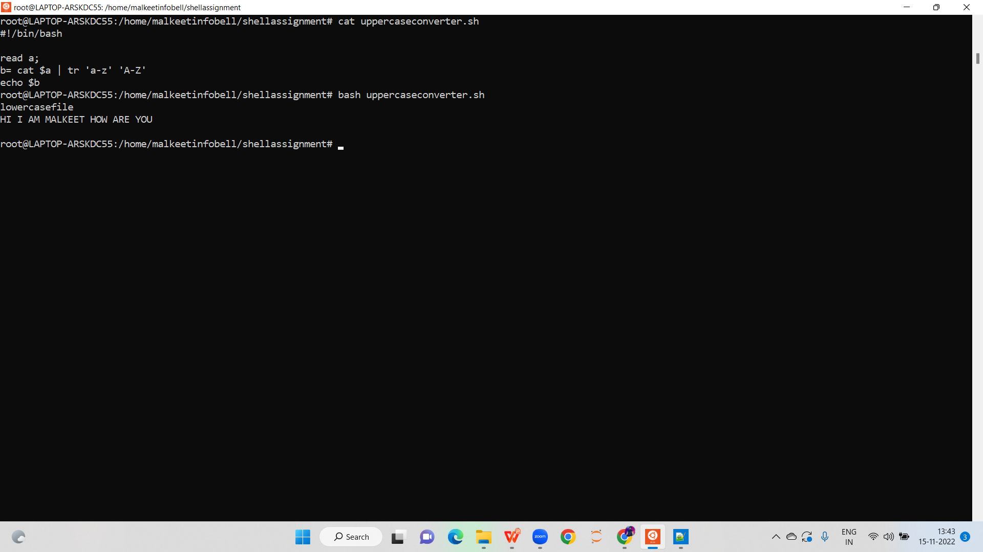
Converting file content into uppercase

Slide 12
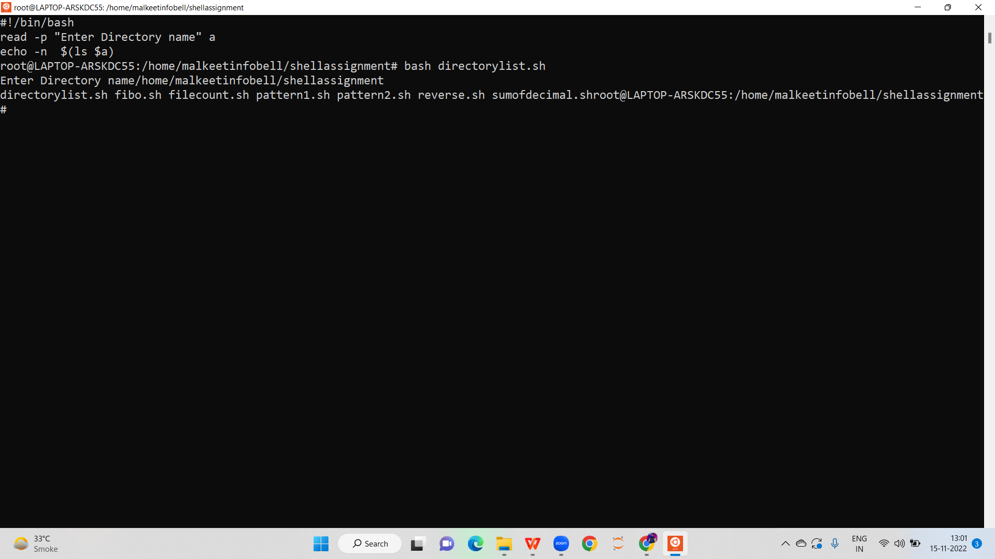
Displaying all contents in directory

Slide 13
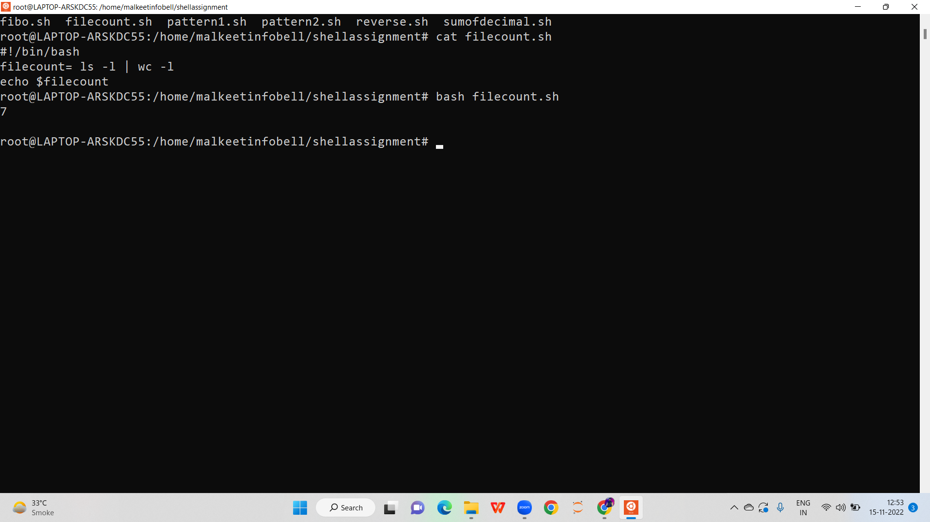
Counting number of files in a directory

Slide 14
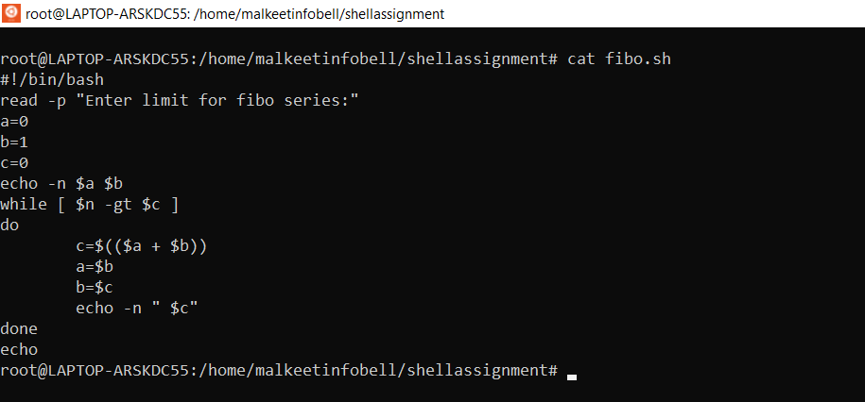
Fibonacci series

